Slide 1
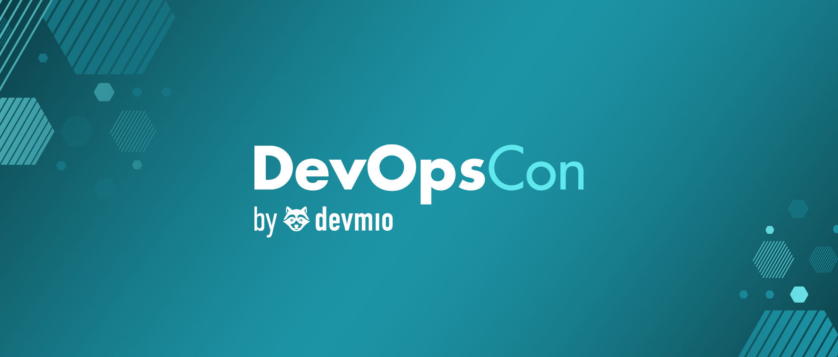
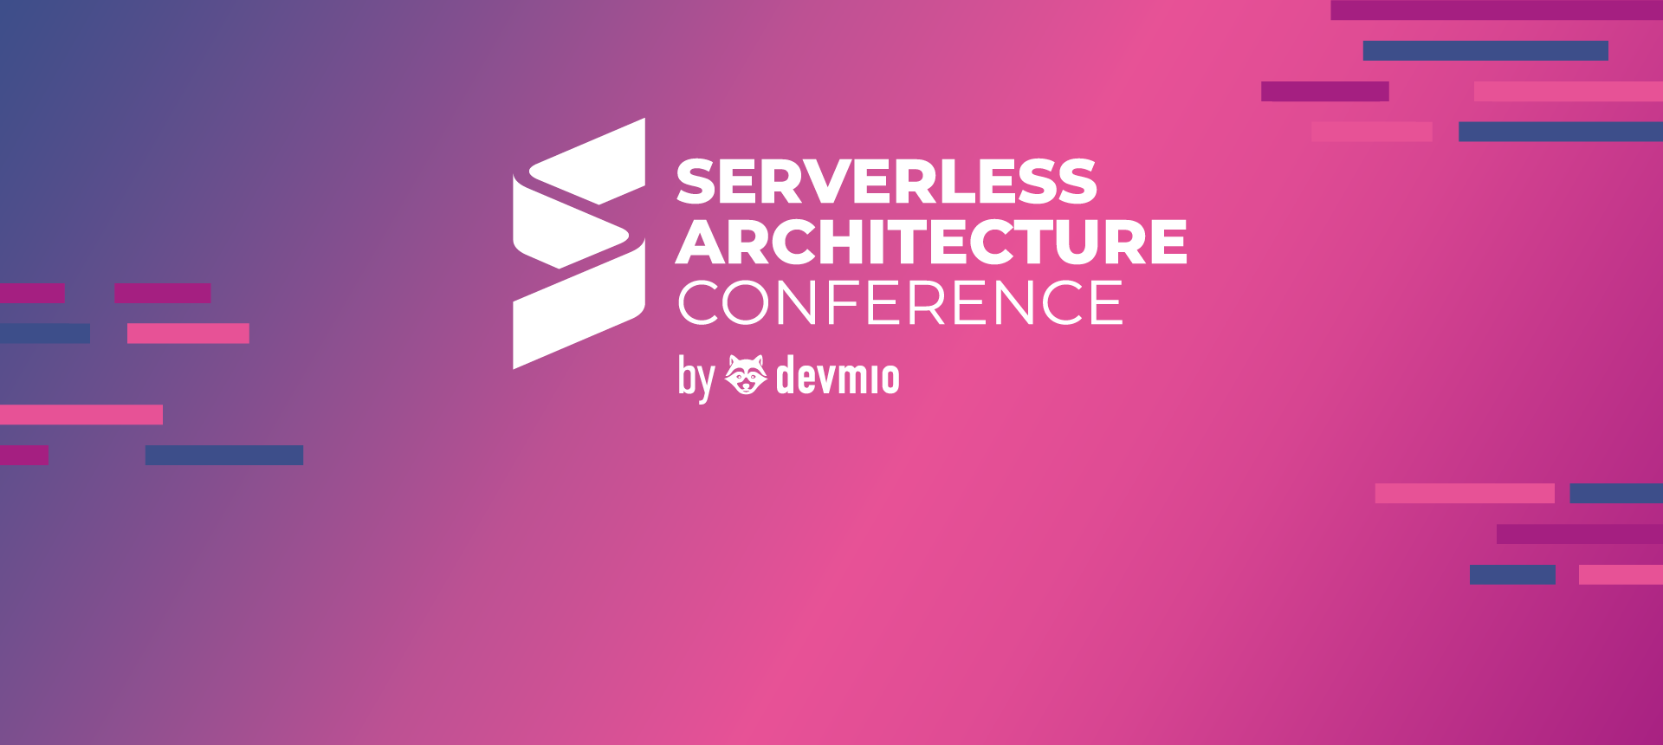
Efficient Serverless Containers with Azure
Roberto Freato Azure MVP / Author / CTO @Retex

Slide 2
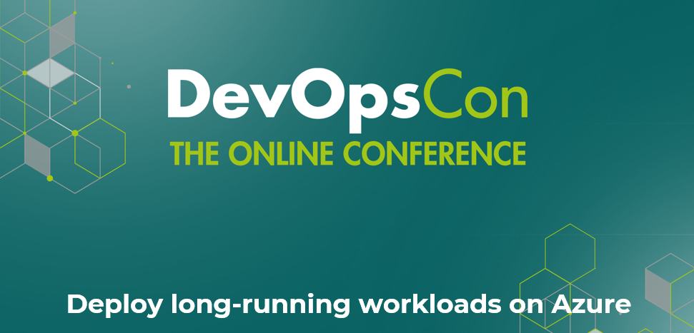
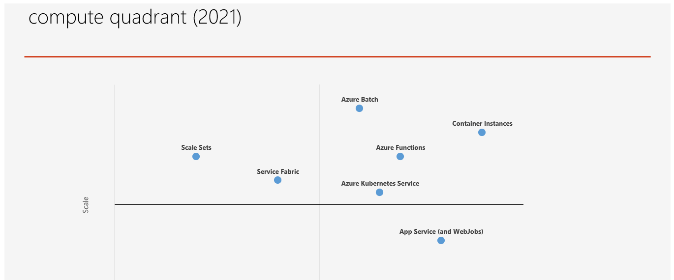
Back in 2021

Slide 3
compute quadrant (2021)

Slide 4
compute quadrant (2022)
Container Apps
Notes:
Budget – 5min
How to read this quadrant and how’s made
Information is accurate but personal
Scale may depends on soft or hard limits of the platform
Examples of soft and hard limits
Ease of management can be the degree of interest we need to have to the underlying infrastructure
Or either the lock-in aspect
Or the industry-standard adherence

Slide 5
My personal forecast about scalable serverless (2022)
App Service
Batch
Container Instances
Container Apps

Slide 6
Today

Slide 7
Major cloud providers have serverless offering
Provider | Compute Services (Functions) | Serverless Container Execution
AWS | AWS Lambda | AWS Fargate
Microsoft Azure | Azure Functions | Azure Container Instances / Apps
Google Cloud | Cloud Functions | Google Cloud Run
Cloudflare | Cloudflare Workers | N/A
IBM Cloud | IBM Cloud Functions | IBM Code Engine
Oracle Cloud | Oracle Functions | Oracle Cloud (OKE) in serverless mode
Alibaba Cloud | Alibaba Cloud Function Compute | Alibaba Cloud Serverless Kubernetes
DigitalOcean | DigitalOcean Functions | DigitalOcean App Platform

Slide 8
Serverless is growing

Slide 9
Areas of concern
 | Compute Services (Functions) | Serverless Container Execution
Speed to deploy | High | Medium / High
Stack-specific boilerplate | High | Low / Medium
Lock-in | - | -
Scalability | High | High
Ease of managment | Low to High | Low to High
Few apps | Higher | Lower
Many apps | Lower | Higher
Existing K8s stack | Lower | Medium / High

Slide 10
K8s is everywhere
The role of kubernetes in 2024

Slide 11
From K8s to Azure Container Apps
Kubernetes
Need to manage despite it’s PaaS
Container Instances
The low-level serverless unit to run containers
Good to handle spikes of AKS or custom jobs
Container Apps
It’s a serverless container solution with steroids
(with some constraints) Can replace K8s
Need to know the specific artifacts
Overall TCO could be higher
Need to build your own governance process
It implements (but hides) many K8s features

Slide 12
DEMO
From K8s to Azure Container Apps
Notes:
Checklist:
K8s Connection
Mongo + OAI connections

Slide 13
From K8s to Azure Container Apps
Kubernetes
Need to manage despite it’s PaaS
Container Instances
The low-level serverless unit to run containers
Good to handle spikes of AKS or custom jobs
Container Apps
It’s a serverless container solution with steroids
(with some constraints) Can replace K8s
Need to know the specific artifacts
Overall TCO could be higher
Need to build your own governance process
It implements (but hides) many K8s features

Slide 14
Takeaways
Serverless containers hide K8s complexity
We need K8s complexity to migrate applications seamlessly
Azure Container Instances is a low-level service
Azure Container Apps is the good fit between
More it grows, more K8s surface will be available

Slide 15
Efficient Serverless Containers with Azure
Roberto Freato Azure MVP / Author / CTO @Retex

